Slide 1

NIS2
L3L1 | 2024-2025
The all-in-one European platform
that simplifies NIS2 compliance and protects your critical infrastructures.

Slide 2




Our Team
ABDELWAHEB SEBA
MOHAMMED RYAD DERMOUCHE
SEDIK SI MEHAND
CHATODIT LOKONGA KANGOLO
Project Leader
UX Designer
Backend Developer
Frontend Developer

Slide 3

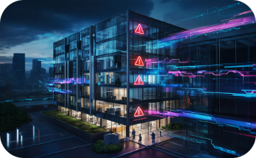
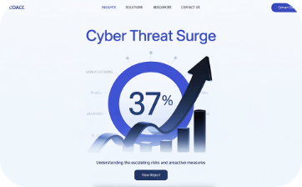

Context
The Cyber Threat in 2023
Cybersecurity has become a critical issue for French organizations. Attacks are multiplying in sophistication and volume, targeting all structures, from SMEs to large companies.
278,770 Digital Attacks
49% Affected Enterprises
+37% Annual Increase
Evolving Threat Landscape

Slide 4



NIS 2
Evolution of the European Cybersecurity Directive
NIS 1
Transition
NIS 2
First European Cybersecurity Directive
Innovation and extension of NIS 1
Application across the entire European area
Strengthened obligations
15 sectors of activity covered

Slide 5


Who must comply?
Enterprises active in the EU exceeding the following thresholds:
Essential Entities (EE)
Important Entities (IE)
≥ 250
≥ 50
Employees
Employees
Minimum required headcount
Minimum required headcount
≥ £50M
≥ £10M
Turnover
Turnover
Minimum annual turnover
Minimum annual turnover
And if not?
Non-compliance = significant administrative and financial penalties

Slide 6


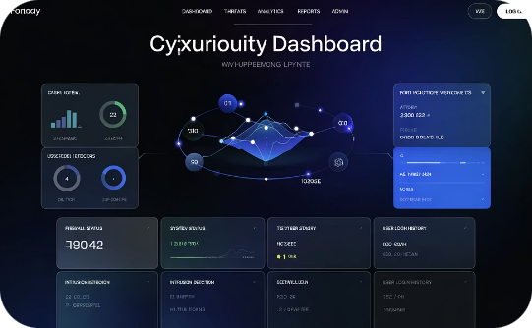
Our solution
Our secure platform guides you towards NIS 2 compliance with an ergonomic interface, security certificates, and a guarantee of confidentiality for all your sensitive data.
Certificates
Confidentiality
Ergonomics
Management and validation of security certificates
Protection of sensitive data
Intuitive and adaptive interface

Slide 7






Project Challenges
The major challenges our team is facing
Limited Time
Strict time constraints
New Technologies
Adaptation to emerging technologies
Cybersecurity Concepts
Mastery of security challenges
Each challenge represents a peak of the complexity triangle that our team must overcome to succeed in the NIS CUBE project.

Slide 8





Work Methodology
Our methodological approach
Requirements
V-cycle
Collection and analysis of needs
Requirements → Design → Implementation → Verification → Validation
Design
Architecture design
Weekly Meetings
Weekly meetings to validate deliverables and adjust planning
Implementation
Development and integration
Verification
Unit and integration testing
Validation
Compliance with requirements

Slide 9
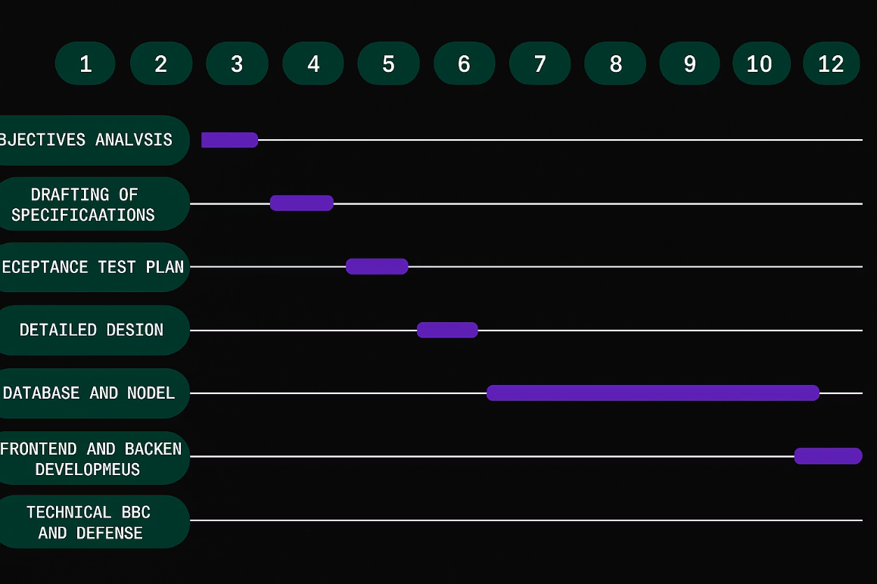
Gantt Diagram
1
Requirements Analysis
100% Complete
2
Design & Architecture
85% Complete
3
Development & Integration
60% Complete
4
Testing & Deployment
Upcoming

Slide 10







Stack & Tools
Our technical architecture and development tools
Node.js
Express.js
Vue.js
Vite
Server-side JavaScript runtime environment
Minimalist web framework for Node.js
Progressive JavaScript framework for user interfaces
Next-generation build tool for the frontend
PostgreSQL
Security
VPS server
Relational database management system
Nginx and other tools for data protection
Virtual private server for secure hosting of the application

Slide 11

Our Impact
Our solution has a significant impact on the efficiency of businesses
1250
847
3500
Statements Generated
Certificates Issued
Hours Saved
Continuous growth since launch
NIS 2 compliance ensured
Productivity gain for our clients

Slide 12




Features
Visualization of key performance indicators
Certificate Recognition
Data Encryption
User Management
Audit Logs
Official validation of NIS 2 compliance
Advanced protection of sensitive information
Simplified access administration
Complete monitoring of system activities
Our features allow for the automated production of compliant reports and the issuance of recognized security certificates.

Slide 13
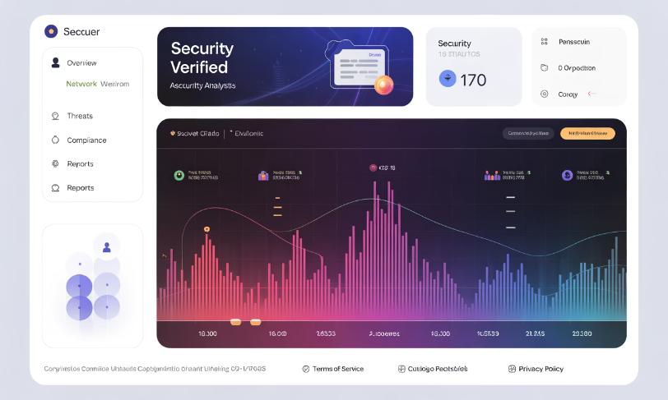
User Interface Features
User Connection
Demonstration of the secure authentication process
Certificate Generation
Automated creation of NIS 2 compliance certificates
Dashboard View
Interface for monitoring and managing key indicators
Our application provides an intuitive interface for managing NIS 2 compliance requirements

Slide 14
Thank you for your attention!
ABDELWAHEB SEBA
MOHAMMED RYAD DERMOUCHE
SEDIK SI MEHAND
CHATODIT LOKONGA KANGOLO
Project Leader
UX Designer
Backend Developer
Frontend Developer

